Slide 1
Safe Housing Partnerships
www.safehousingpartnerships.org
The new website for the Domestic Violence and Housing Technical Assistance Consortium
Notes:
Excited to share the newly launched Safe Housing Partnerships website, which is a product of the Domestic Violence and Housing Technical Assistance Consortium
Website is full of information, resources, and tools to help advance advocates’ work at the intersections of domestic violence, sexual assault, housing, and homelessness

Slide 2
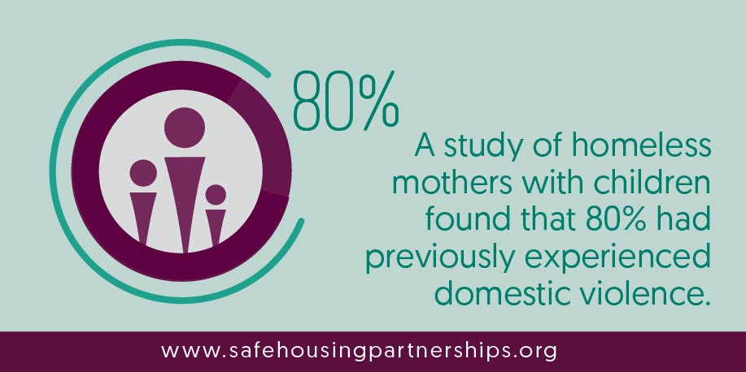
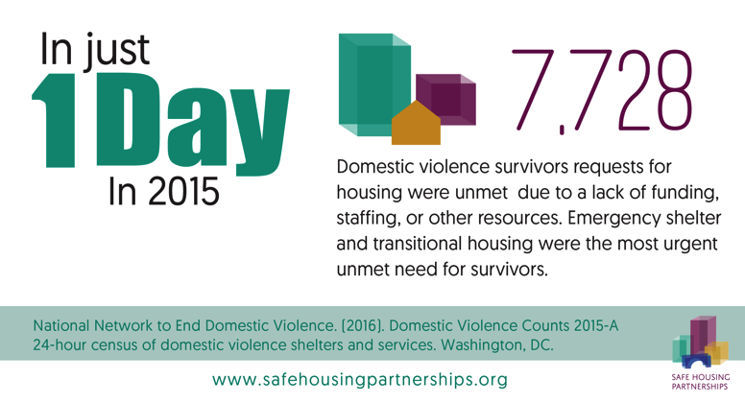
Understanding the Intersections
Data, infographics, literature reviews, and reports that:
Describe the intersections between domestic violence, sexual assault, homelessness, and housing
Provide information on the incidence and impact of homelessness generally and among specific populations
Notes:
First main page on the site is designed to introduce and explain this critical intersection
Explores the connections between domestic violence, sexual assault, and housing instability
Uses infographics, literature reviews, and other studies and reports to share compelling data on the incidence and impact of homelessness generally, as well as for victims

Slide 3
Building Partnerships
Strategies for building effective and sustainable partnerships
Case studies exploring how programs and communities developed collaborative partnerships across systems
Currently featuring the District Alliance for Safe Housing’s Domestic Violence & Housing Taskforce and the Kentucky Coalition Against Domestic Violence Rapid Rehousing Program
Notes:
The Building Partnerships page includes tips and strategies highlights the importance of working collaboratively across sectors to address survivors’ housing needs
It provides tips and strategies for building relationships between DV/SA service providers, homelessness service providers, private landlords, public housing authorities, state-level coalitions, funders, and national organizations
This page also features case studies with real-life examples of programs and communities that have built effective, successful partnerships

Slide 4
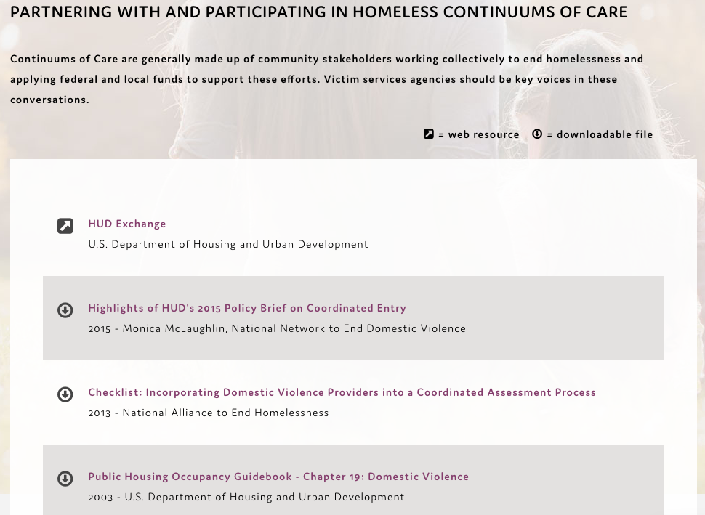
Employing Key Approaches
Organized resource collections of documents, websites, webinars, and more in four key areas:
Creating Safe Temporary Housing
Facilitating Access to Safe Permanent Housing
Preventing Homelessness
Survivor-Centered Services
Notes:
The Employing Key Approaches page is the real “meat” of the website, and is an organized resource library of reports, research studies, best practice guides, webinars, websites, training tools, manuals, advocacy guides, and more
This content is organized into four key approaches:
Creating Safe Temporary Housing – which has resources about emergency shelter and transitional housing
Facilitating Access to Safe Permanent Housing – which has resources about Continuums of Care; coordinated entry; HMIS and comparable databases; rapid rehousing, Housing First, and other similar approaches; and low barrier programs
Preventing Homelessness – which has resources about general prevention strategies, flexible funding, and federal, state, and local laws and protections
Survivor-Centered Services – which has resources about confidentiality and safety, voluntary services, trauma-informed approaches, working with underserved or marginalized survivors, economic advocacy, and services for children and youth, as well as survivor and advocate toolkits
The Consortium team will be continuously adding new resources and content so be sure to check back frequently!

Slide 5
Public Policies
Links to federal laws, regulations, and policies, including:
Violence Against Women Act
HEARTH Act
Affirmatively Furthering Fair Housing
Notes:
The Public Policies page contains links to federal laws, regulations, and policies relevant to DV/SA and housing – it’s a “one-stop” shop so you don’t have to go hunting for all this information

Slide 6
Other Key Website Features
About the Consortium
Technical Assistance
Learn more about:
The four federal offices behind this innovative and unprecedented partnership
The four organizations that make up the collaborative TA Team
Request technical assistance or training from the Consortium
Notes:
On the website, you can also learn more about:
The four federal offices came together in an unprecedented way to create and support this Consortium
US Department of Justice, Office on Violence Against Women (OVW) and Office for Victims of Crime (OVC)
US Department of Health and Human Services, Family Violence Prevention and Services Program (FVPSA)
US Department of Housing and Urban Development, Office of Special Needs Assistance Programs (SNAPS)
The four TA Team organizations that are working collaboratively to provide in-depth TA and resources to both the DV/SA and housing/homelessness fields
National Resource Center on Domestic Violence
National Alliance for Safe Housing
National Network to End Domestic Violence
Collaborative Solutions
You can also request TA or training directly from the site

